Slide 1
Review of Java
… or maybe not

Slide 2
Have some class...
public _____ Foo _____ Bar _____ Comparable {
/** name of this Foo */
private String name;
/** initialize a new Foo */
public ____ Foo(String name) {
______________ = ________
}
public String toString() { return name; }
// what other method is required?
}

Slide 3
Make the name immutable
public _____ Foo _____ Bar _____ Comparable {
/** name of this Foo */
private _________ String name;
...
immutable means you cannot change the value after it is set the first time.

Slide 4
Name these Primitives
32-bit whole numbers -9999 …. 0, 1, 0x10
64-bit whole numbers, written like 4L
true and false
'ก', 'ด', \u0420
2.98E+08
8-bit values 0, 1, …, 255 (not int values)

Slide 5
What is the result?
> char c = 'A';
> c + 1
> (int) c
> (short) c
> (byte) c
> (char) 66
(int) c means "convert the value to an int".
This is called a cast.
You can use class name in a cast, too:
(Character) c

Slide 6
What is the result?
> c = 'ก' ; (gau gai)
> (int) c
> ++c
> (char) c
Java uses Unicode for char and Strings,
but the output may not be readable if the output device doesn't use Unicode

Slide 7
> int n = 10;
> int x = n++;
> x // what is the value?
> int y = ++n;
> y // what is the value?
Nerdy Math. What is the output?
> n = 10;
> int y = n+++n+++n++;
> y
(a) 30 (b) 31 (c) 32 (d) 33 (e) Error

Slide 8
How are these different?
// 1 Billion + 2 Billion
> 1000000000 + 2000000000
> 1000000000L + 2000000000L
> 1E9 + 2E9
// in Java 7 you can write _ in numbers
> 1_000_000_000L + 2_000_000_000L

Slide 9
Bizarre Numbers
System.out.println( 12 );
System.out.println( 012 );
System.out.println( 0x12 );
System.out.println( 012 + 0x12 );

Slide 10
Which data type should you use for ...
// the day of the month
________ day = 13; // 13 Jan 2015
// population of the world
________ worldPop = (7 billion) ;
// Bank account number
// example: 001230055555
________ accountNumber = . . .

Slide 11
How to Convert Primitive to Object?
A List (like ArrayList) can only contain objects.
How can we add primitive values (like int) to a List?
List mylist = new ArrayList( );
int n = 51651111;
mylist.add( n ); // Wait? How is this possible?
Try in BlueJ Codepad:
> List list = new ArrayList( );
> list.add( "hello" )
> list.add( 10 ) // what is being put in the List?
> list.get( 0 )
"apple" (String)
> list.get( 1 )
<object reference> (Integer)

Slide 12
Wrapper Classes
Primitive Wrapper
boolean Boolean
char Character
byte Byte
short Short
int Integer
long Long
float Float
double Double
double root = Math.sqrt( 2.0 );
Double d1 = new Double( root );
// same thing: automatic boxing
Double d2 = root;
// print as a string
out.println( d2.toString( ) );
// static method to make a string
out.println( Integer.toString( 2 ) );

Slide 13
Methods to convert to/from String
int n = 29*31;
// convert n to a String
String product = Integer.toString(n);
// parse integer value of a String
String s = "123";
int m = Integer.__________ (s);
// parse double value of String s
double d = ______________________;

Slide 14
parseInt(string) versus valueOf(string)
What is the difference?
String s = "123";
Integer.parseInt( s )
Integer.valueOf( s )

Slide 15
Useful Constants in Numeric Wrapper classes
What is the largest "int" value?
What is the smallest "long" value?
What is the range (smallest, biggest) of double?
int maximum =
long minimum =
double minsize =
double maxsize =

Slide 16
What value is after the biggest value?
int n = Integer.MAX_VALUE;
n = n + 1;
System.out.println( n );
double d = Double.MAX_VALUE;
d = d + 1;
System.out.println( d );
d = d * 1.000001;
System.out.println( d );

Slide 17
Packages
Java uses packages to organize classes.
Packages reduce size of name space and avoid name collisions (like Date in java.util and java.sql).
Q: Which package contain these classes?
  Java language core classes (Object, String, System, ...).
  You never have to import this.
  Classes for input and output, like InputStream, FileReader
  Date classes and collections (List, ArrayList)
  Utilities Scanner, Arrays,
  Java Graphics frameworks (2 packages)

Slide 18
Packages
Where is …
String class java.lang - core classes of the java language
Scanner … java.util - utilities and Collections (ArrayList)
Date … java.util - date and time classes (expect java 8)
InputStream and FileReader … java.io
java.io – Input & Output classes
javax.swing - Swing graphics (also javax.swing.___)
java.awt - the AWT graphics framework

Slide 19
Identify each of these
Date
double
Double
System.out
System.out.println( )
System.nanoTime( )
Double.MAX_VALUE
java.lang.BigInteger
java.lang.Comparable
java.io
java.util.ArrayList
java.util.List
Is it a...
package
class
primitive type
attribute ("field") of object
static attribute of class
method (static or instance)
constant
interface
???

Slide 20
What is the output?
System.out.println( 3 + 4 );
System.out.println( "3" + 4 );
System.out.println( '3' + 4 );
System.out.println( 3 + "4" );

Slide 21
Bit Operations
> int a = 7;
> int b = 10;
> a & b
> a | b
> a ^ b
> a == b
> a = b
> a && b

Slide 22
Passing arguments to methods
public void swap(int a, int b) {
int temp = a;
a = b;
b = temp;
}
// elsewhere in the code...
int n = 10;
int m = 20;
swap( m, n );
What is m?

Slide 23
Define a Person class
Person
- name: String
<<constructor>>
Person( name: String )
getName( ): String
setName( newname: String ): void
toString(): String
Person p = new Person( "Pee" );
p.setName( "Nong" );
System.out.println( p.toString() ); // prints "Nong"

Slide 24
Passing arguments, again
public void swap(Person a, Person b) {
Person temp = a;
a = b;
b = temp;
}
// elsewhere in the code...
Person m = new Person( "Meaw" );
Person n = new Person( "Nok" );
swap( m, n );
What is m.toString() ?

Slide 25
How about this?
public void swapName(Person a, Person b) {
String temp = a.getName();
a.setName( b.getName() );
b.setName( temp );
}
// elsewhere in the code...
Person m = new Person( "Meaw" );
Person n = new Person( "Nok" );
swapName( m, n );
What is m.toString() ?

Slide 26
Difference between "==" and .equals?
> Double x = new Double(10);
> Double y = new Double(10);
> x == y
> String s = "yes";
> String t = "yes";
> s == t
> String u = new String("yes");
> s == u
> s.equals(u)

Slide 27
How to write equals( )
You should usually define equals( ) like this:
public class Person {
public boolean equals( Object other ) { … }
Not like this:
public boolean equals( Person other ) { ... }

Slide 28
Javadoc
package ku.oop.contacts;
import java.util.List;
/**
* A Person contains information about a
* person including name and contact info.
* @author Bill Gates
* @since 2014.01.12
*/
public class Person {
/** person's name, of course */
private String name;
Write complete sentences, ending with period!

Slide 29
Method Javadoc
/**
* Set the person's birthday.
* @param birthday a date containing the
* person's birthday. Must not be null.
*/
public void setBirthday(Date birthday) {
if (birthday == null)
throw new IllegalArgumentException(
"Read the javadoc, stupid!");
.
.

Slide 30
Method Javadoc with Return
/**
* Withdraw money from the purse.
* @param amount is amount to withdraw.
* @return array of moneys withdrawn from
* purse, or null if can't perform the
* requested withdraw.
*/
public Money[] withdraw(double amount) {
if (double <= 0.0) return null;
.
.

Slide 31
Bad Javadoc
/**
* The Person class has name and birthday
* @Bill Balmer
* @Version 1.0
*/
package ku.oop.badcode;
public class Person {
private String name;
/**
* get the firstname
* @param k is the index of last char
*/
public String getFirstname( ) {
int k = name.indexOf(' ');
return name.substring(0,k); // bug?
}

Slide 32
Good Code has Documentation
Use documentation to describe classes and methods.
Describe what and why – not "how" which is obvious from the code.
Describe rationale and logic which is not obvious from code.
// A useless comment
// sum elements in the array
int sum = 0;
for(int k=0; k<array.length; k++) {
sum += array[k];
}
No Javadoc = No Credit

Slide 33
Generate Javadoc from your Code
3 ways:
the javadoc command
let Eclipse (or BlueJ or Netbeans or …) do it
automatic build system, like Maven

Slide 34
JAR files
What is a JAR file?
Why use them?
How to create one?
WHERE ARE THE JDK CLASSES?
Classes in the Java SE API:
4,024 in java 7
3,793 in java 6
3,279 in java 5.0
Actually there are MORE classes that this – some classes are not documented in the API. And this number does not include interfaces.
These classes are on your computer (in the JDK). Where are they?

Slide 35
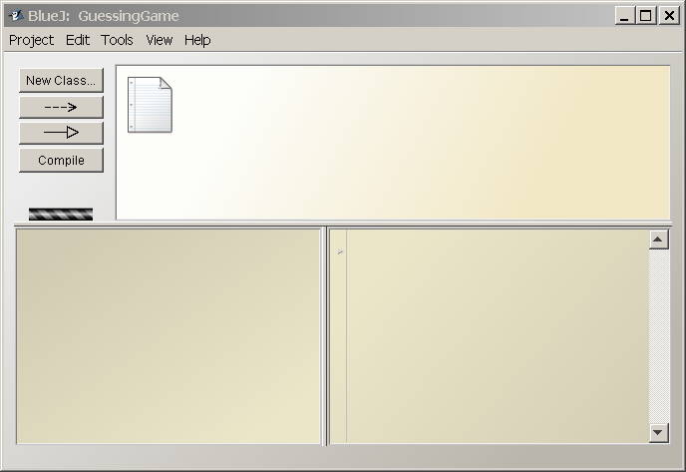
BlueJ IDE Layout
Current Project
Object Bench
Code Pad

